Slide 1


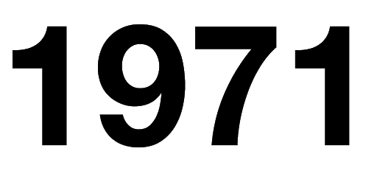
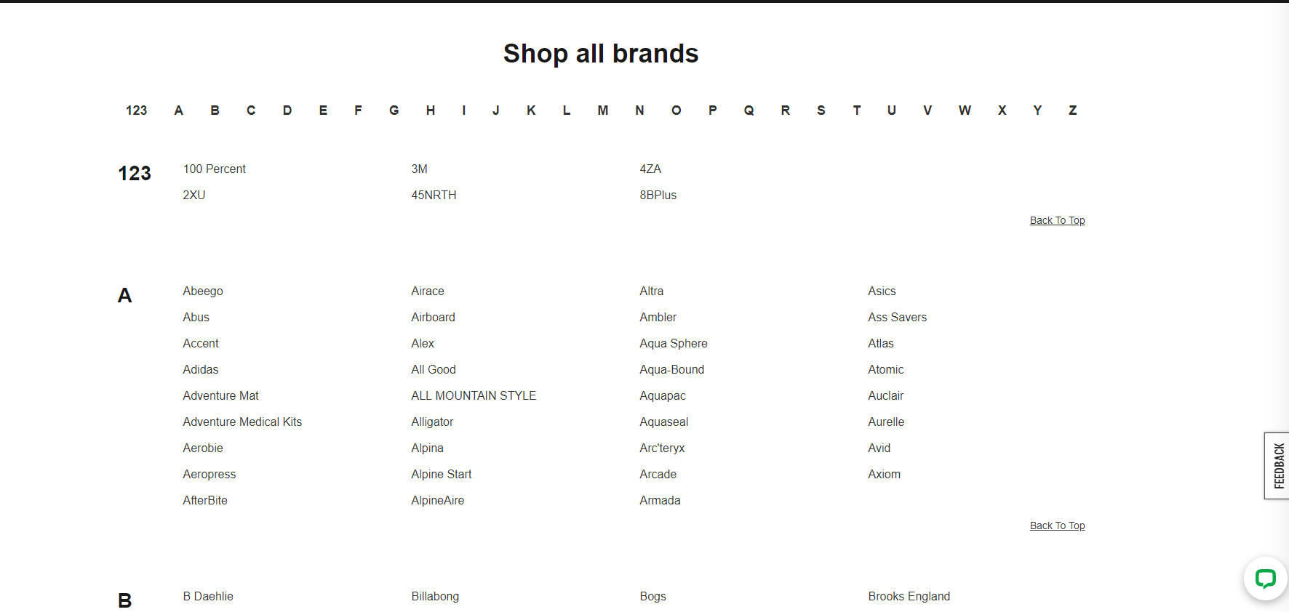
WCD Web Scraping Project
Ernesto Ramos

Slide 2
Agenda
Motivation for choosing MEC
Showcase the MEC website
What kind of data I explored
Main findings
Conclusions
Challenges
Next steps

Slide 3




Motivation for choosing MEC?

Slide 4





Motivation for choosing MEC?

Slide 5
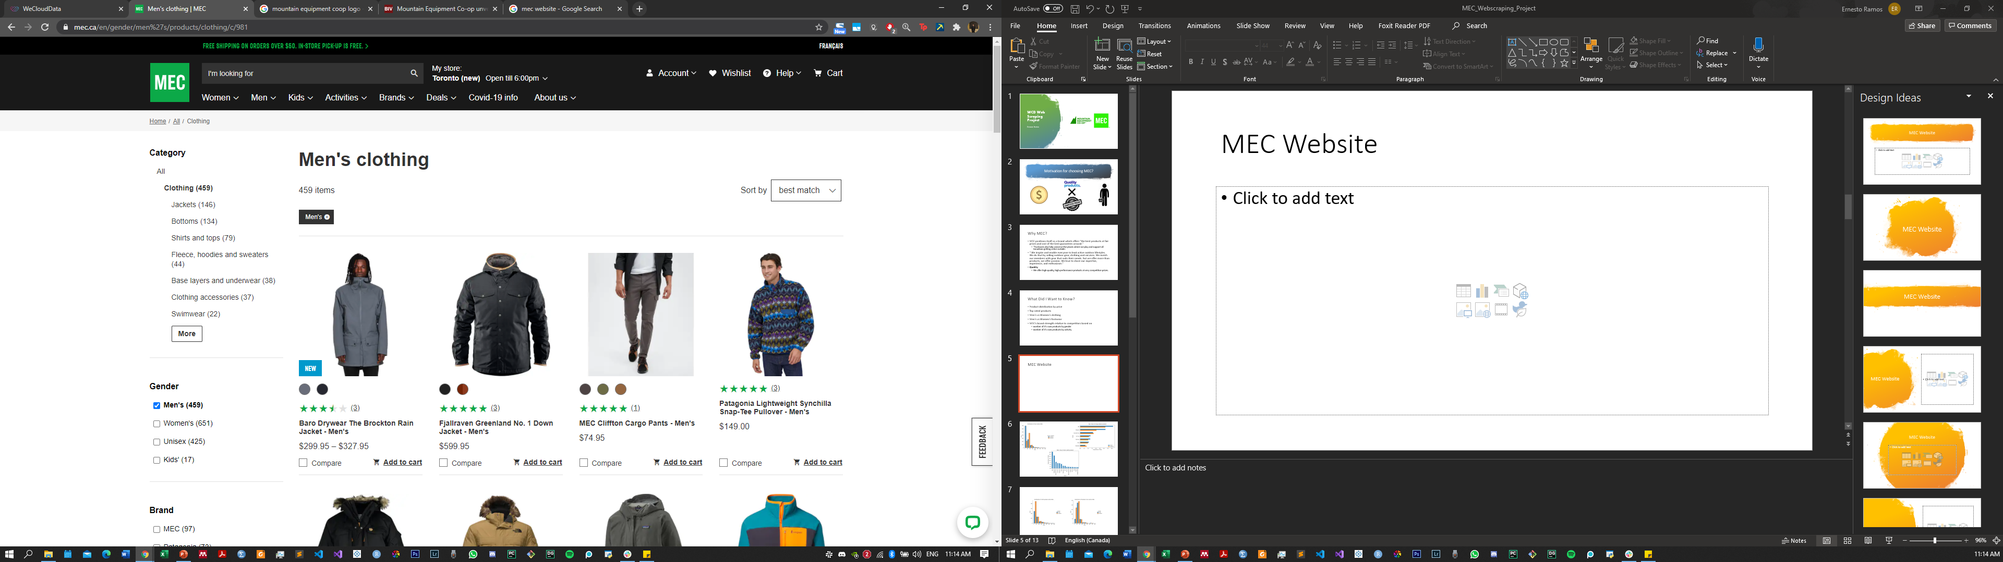
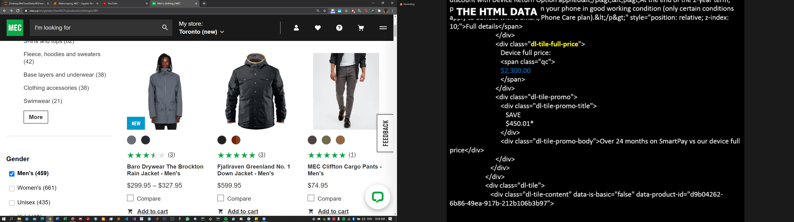
MEC Website

Slide 6
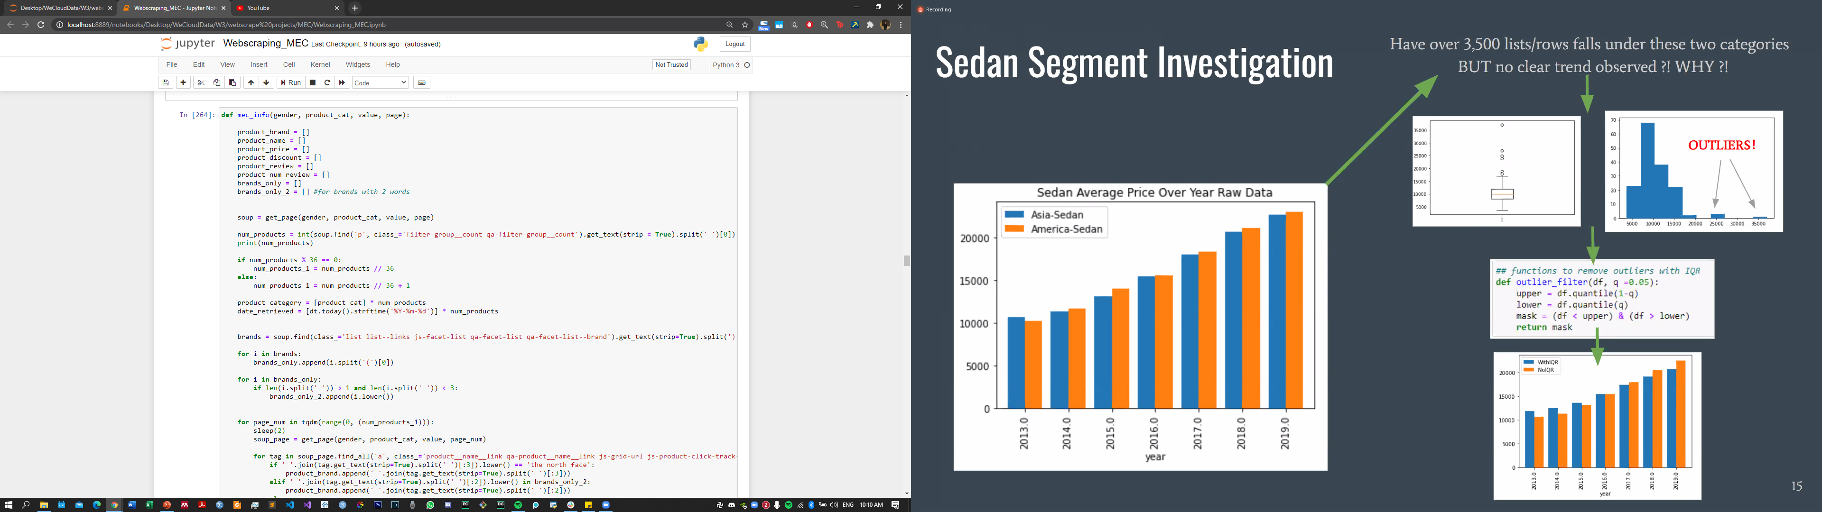
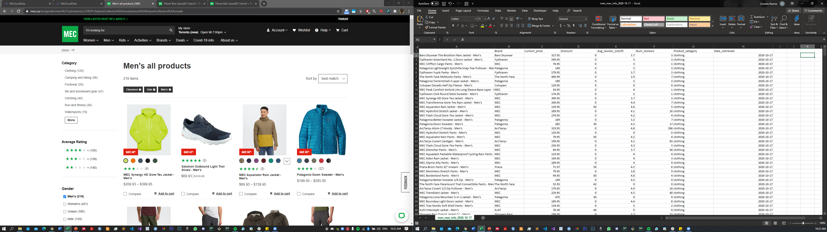

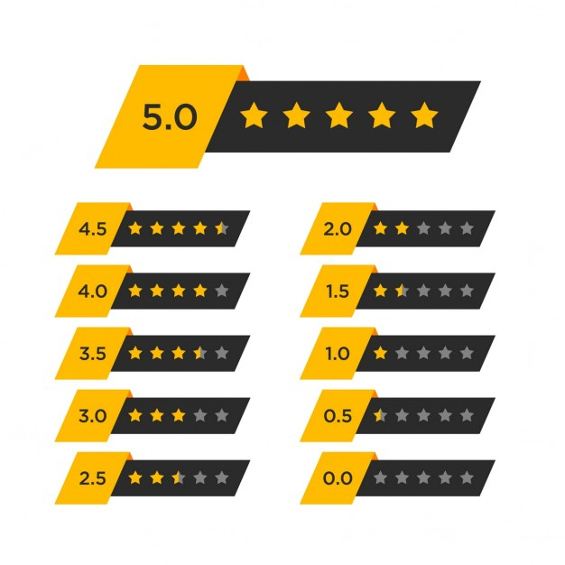
What Kinds of Data Did I Explore?
Men’s vs Women’s Gear
Clothing (~1200 items)
Footwear (~800 items)
Activity
Camping and hiking (~2600 items)
Climbing (~800 items)
Cycling (~1400 items)
Snow sports (~1000 items)
Watersports (~500 items)

Slide 7
What Can I Do With This Data?
Product price vs rating
Product discount vs rating
Regression of the above displaying line of best fit
Boxplot displaying price distribution
MEC?
Rating
Price ($)

Slide 8
Main Findings: Clothing

Slide 9
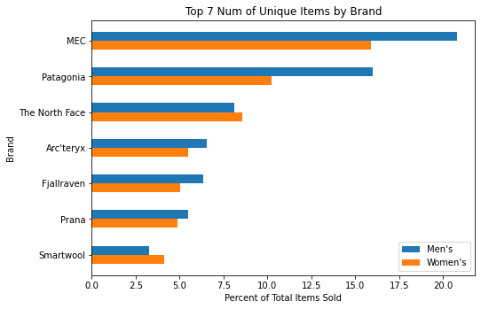
Top Brands by Clothing Items Sold

Slide 10
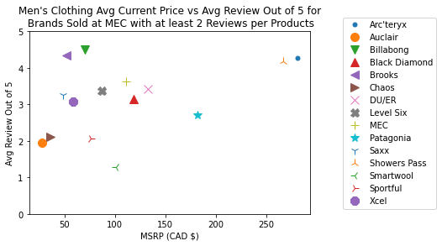
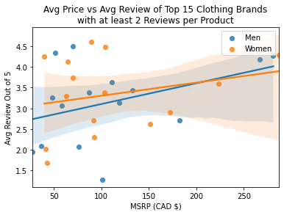
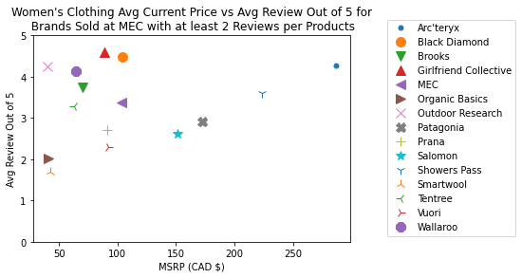
How Well are MEC Clothing Products rated?

Slide 11
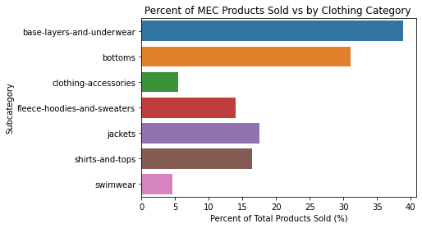
Clothing: Base Layers and Bottoms

Slide 12
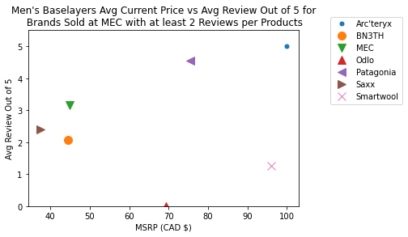
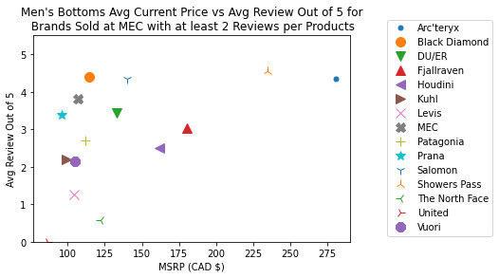
Clothing: Base Layers and Bottoms

Slide 13


MEC Products by Activity

Slide 14
Main Findings: Camping and Hiking

Slide 15
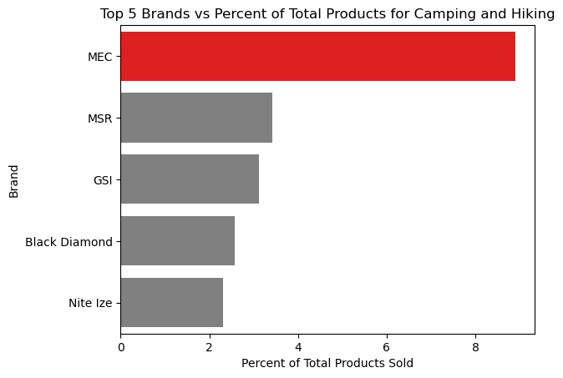
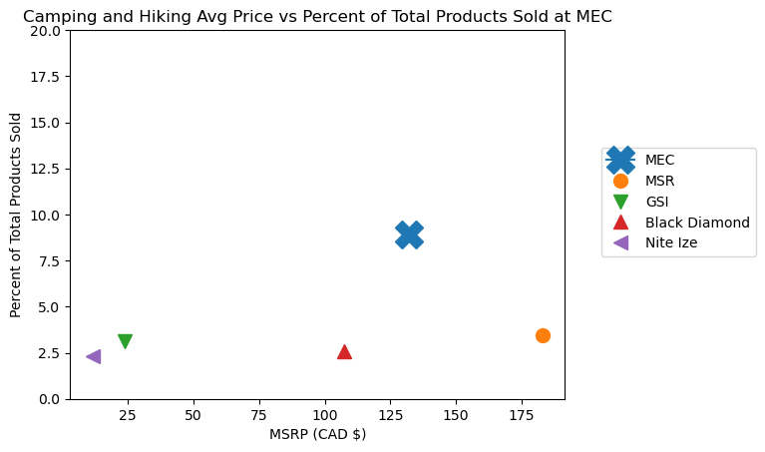
Percent of MEC Products Sold for Camping and Hiking

Slide 16
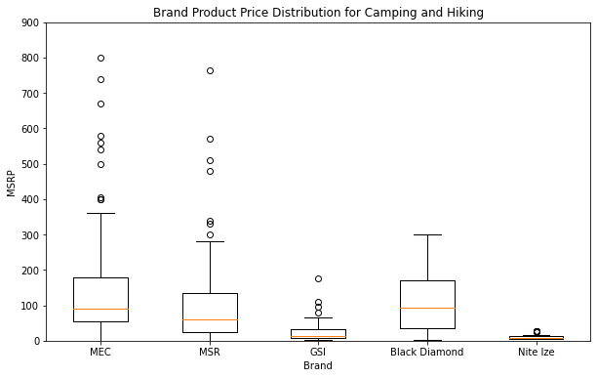
Distribution of Product Prices for Top 5 Brands with the Most Item Selection

Slide 17
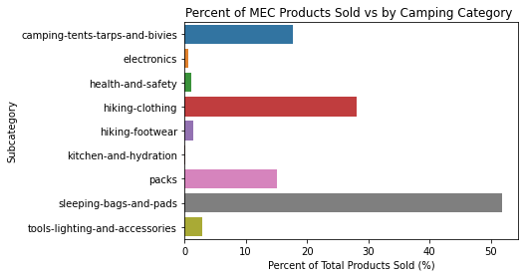
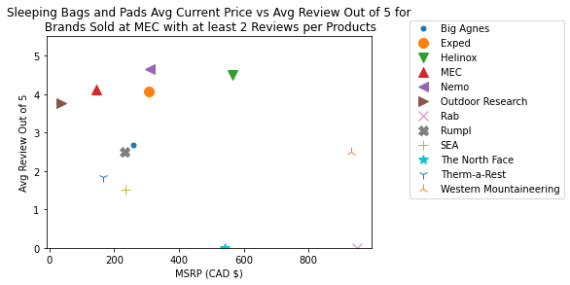
Camping: Subcategories

Slide 18
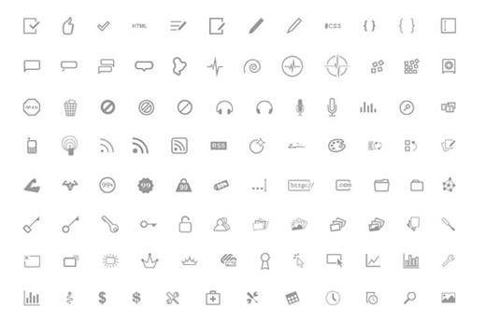

Conclusions

Slide 19


Conclusions

Slide 20

Main Challenges
Planning what kind of data I wanted to collect and how to tell a story from it.
Graphing the data in the way I wanted it to be visualized.
i.e. stacked bar charts.
Getting the same marker for the brand or colour.

Slide 21
Next Steps
Further sub categorical analysis for clothing and activities
Footwear category
Consideration of seasonality
Consideration of inventory / stock
Product selection =/= >products sold or greater revenue

Slide 22
Questions?

Slide 23
Supplementary Slides

Slide 24
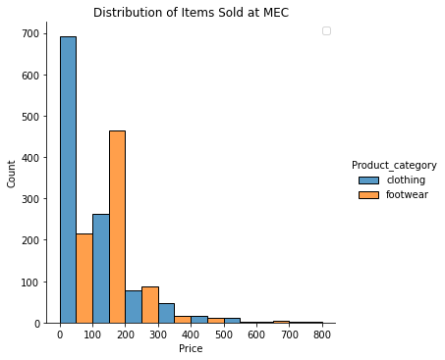
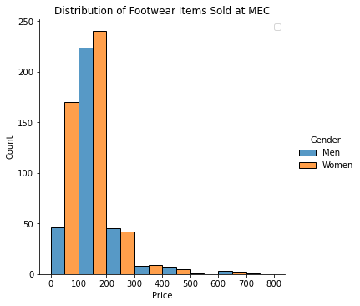
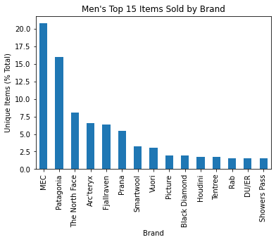
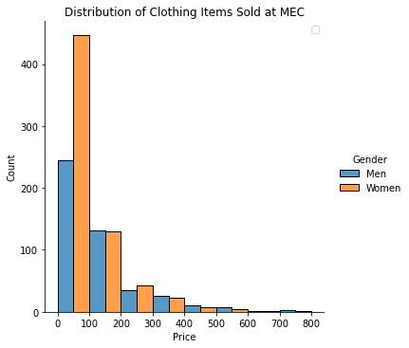

Slide 25
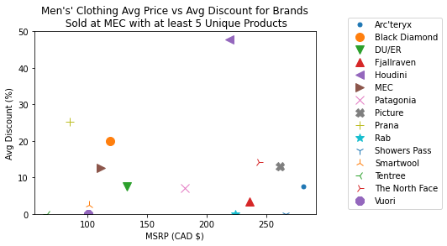
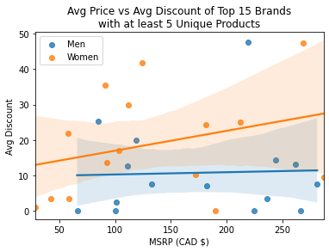
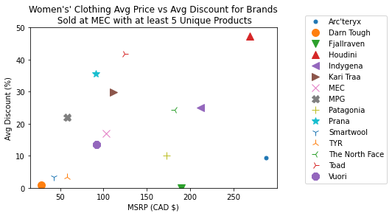
Does MSRP correlate with Product Discount?
Notes:
Looked at only products with at least 5 unique products. That way, the discount amount would not be skewed too a larger degree if let’s say one product was on sale while the other’s were not.
So for MEC, while they are in the intermediate range for product prices, overall, they also do not put their products on sale to the same degree that competitors do which suggests that they stick to their values of fair pricing for value.

Slide 26
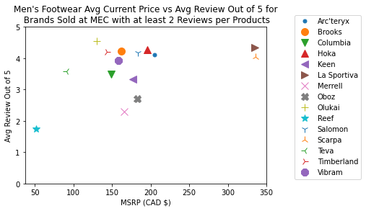
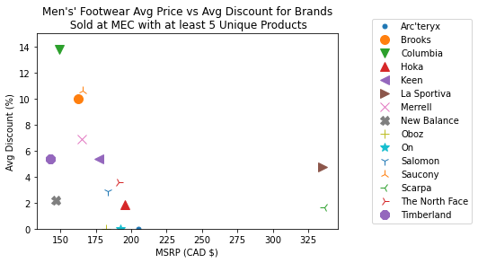
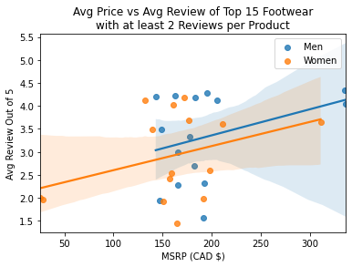
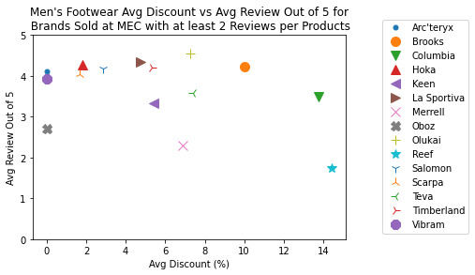
Footwear vs Discount

Slide 27
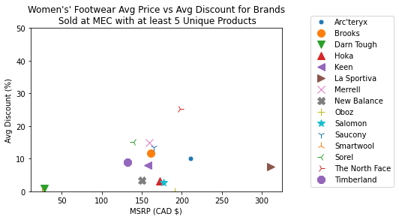
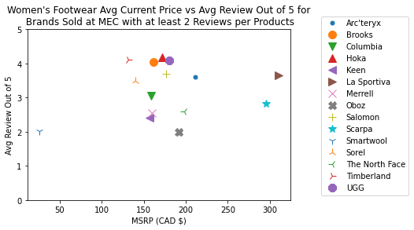
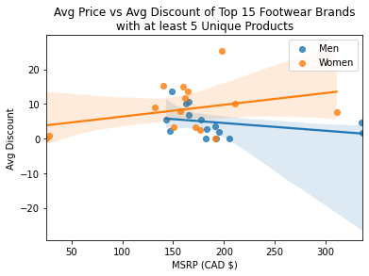
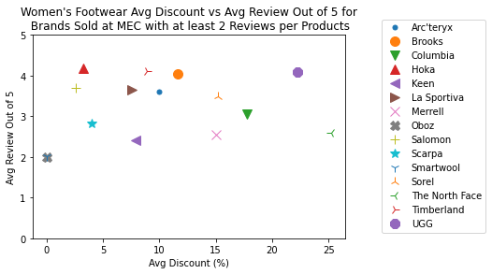
Footwear vs Avg Review
Notes:
-Does this imply men’s products footwear worse than women’s footwear? Probably not…. Next steps.

Slide 28
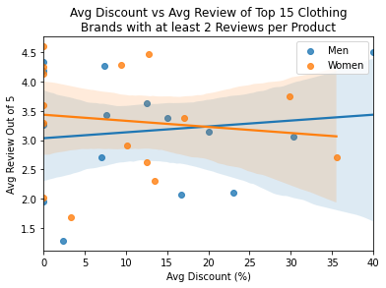

Slide 29
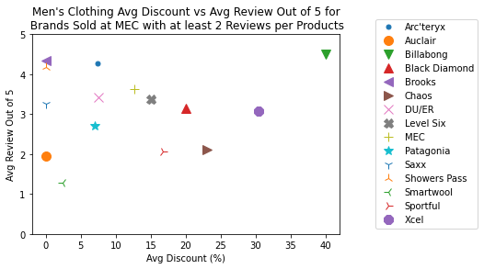
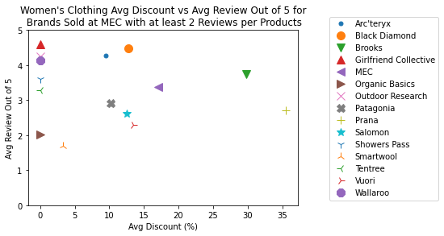
Do Ratings Correlate with Product Discount?

Slide 30
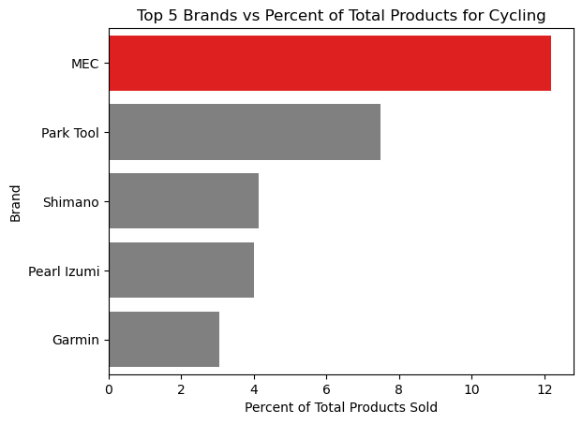
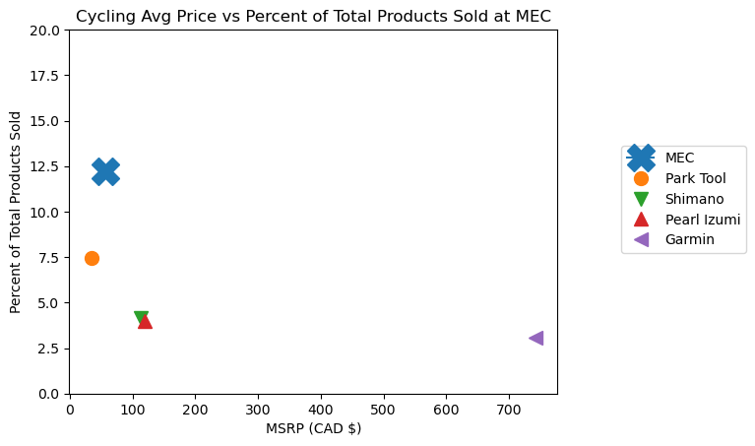
MEC Product’s Sold vs Cycling

Slide 31
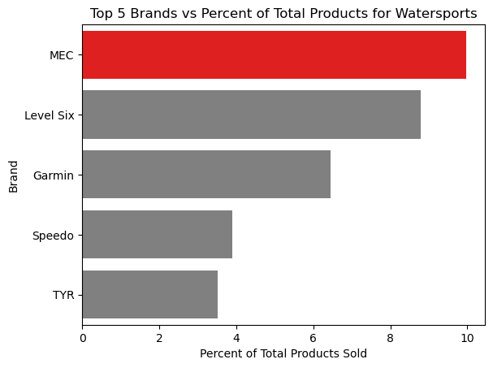
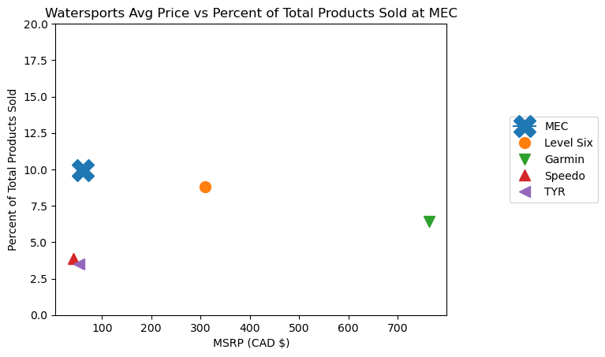
MEC Product’s Sold vs Water Sports

Slide 32
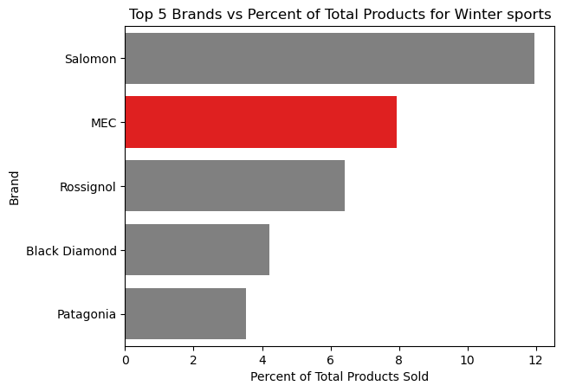
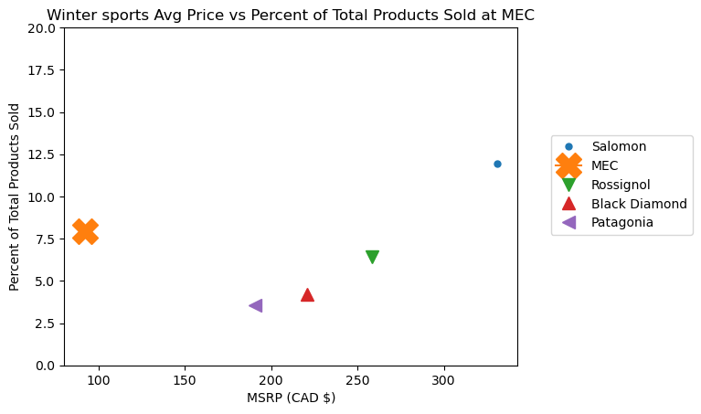
MEC Products Sold vs Winter Sports

Slide 33
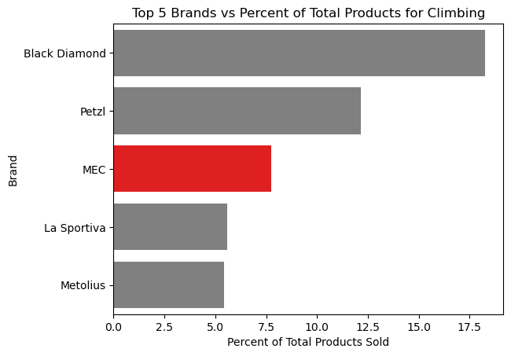
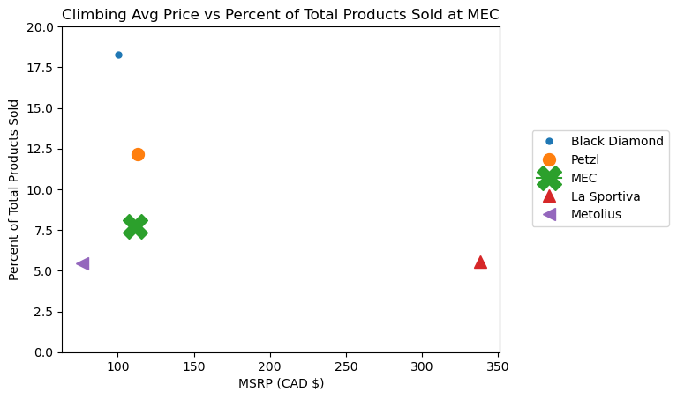
MEC Products Sold vs Climbing

Slide 34
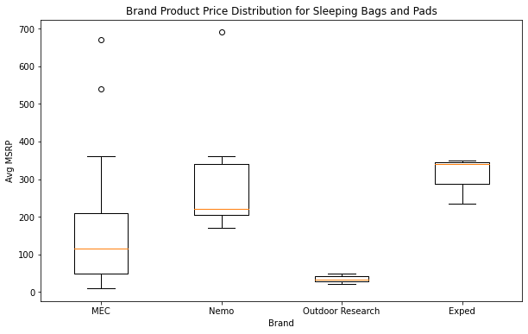
Camping: Sleeping Bags and Pads

Slide 35
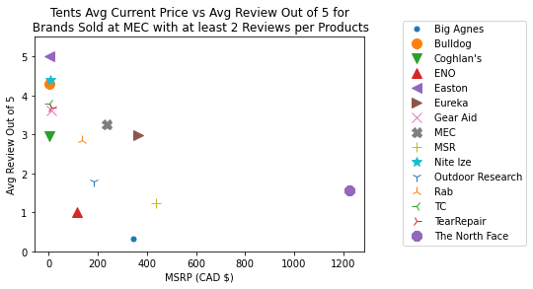
Camping: Tents, Tarps and Bivies
Notes:
MEC trying to encompass the whole spectrum
Activity cat vs % of products sold by MEC

Slide 36
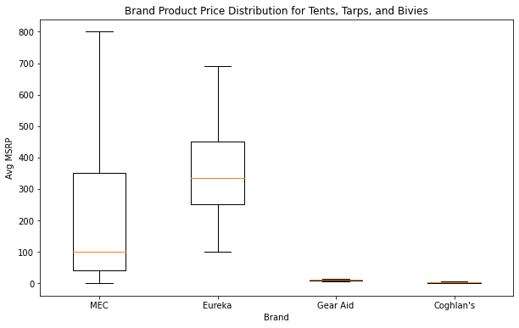
Camping: Tents, Tarps and Bivies

